Slide 1
Retail Training Strategy
March 2025

Slide 2
RETAIL TRAINING SECTOR SCORECARD FY25
Sector
BAMCO | - | 7 | 1 | 8
CHE | Mandatory - 67 | 16 | 6 | 89
C-K12 | - | 3 | - | 3
CCL | - | 9 | - | 9
EUREST | Mandatory - 14 | 176 | 5 | 195
FLIK | 55 | 137 | 5 | 197
LEVY | Mandatory - 3 | - | 1 | 4
MHC | Mandatory - 48 | 55 | 37 | 140
RA | Mandatory - 1 | 3 | - | 4
TOUCHPOINT | 21 | 24 | 17 | 62
Drink it Up
Hospitality 101
RC 2.0
FY25 YTD
*Updated monthly

Slide 3
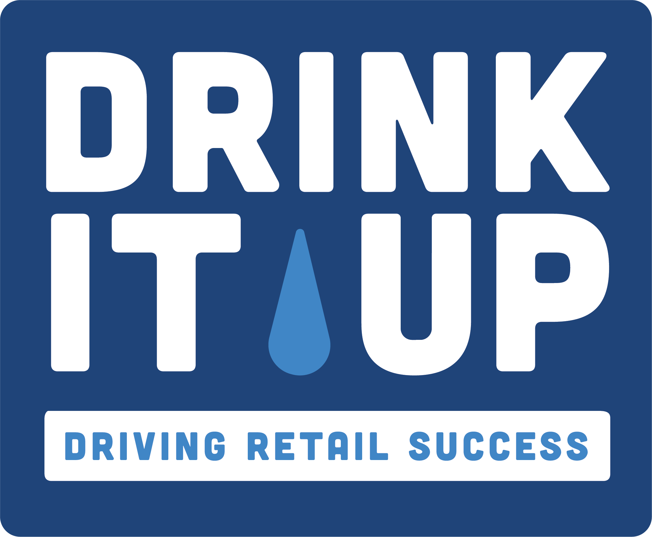

Retail Training: FY2025 YTD
Total B&I = 70 | Total B&I = 10
+4% UNITS SOLD (pre vs. post training, where at least one manager completed Drink it Up!) | +12% Sales +9% Check Average (average graduate results)
“It’s fantastic to see it available in both English and Spanish, and I appreciate the alignment with the new beverage toolkit.” | “This was such a great course! I thoroughly enjoyed it. There was so much useful information that I haven’t seen in other (courses).”
FY2025 YTD ENROLLMENT
IMPACT
TESTIMONIAL
Notes:
Retail training designed to equip managers and frontline associates with the essential skills and knowledge needed to excel in retail.

Slide 4
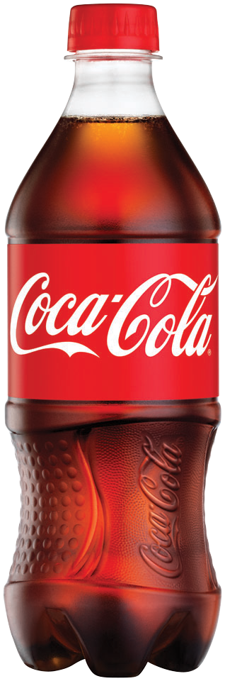
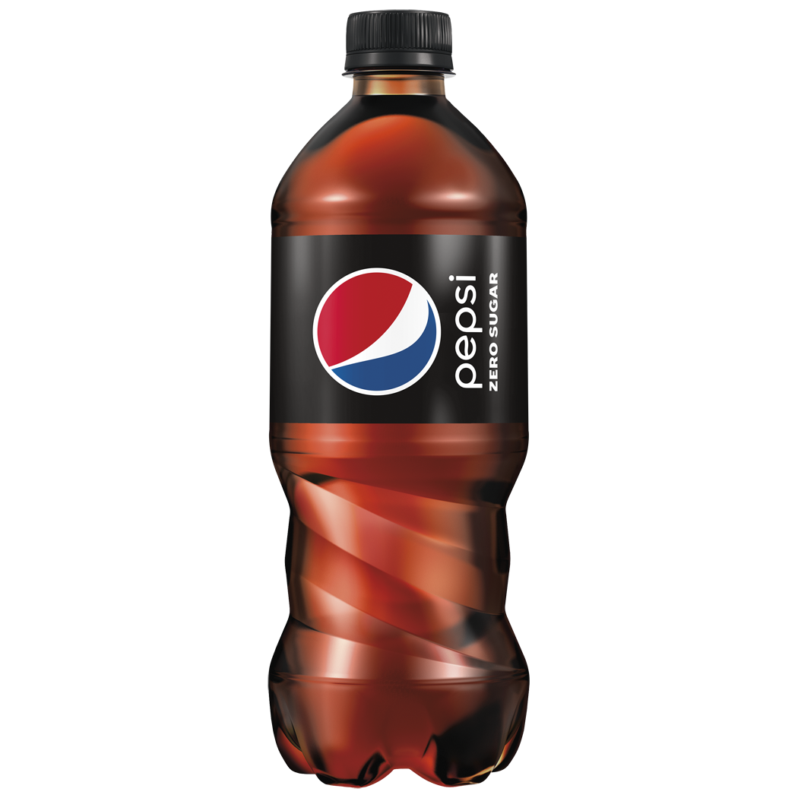
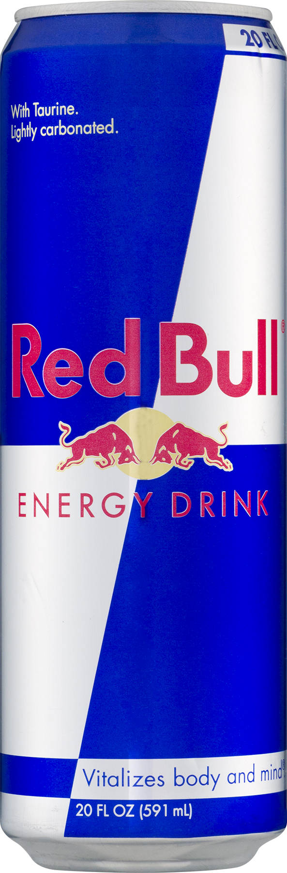
MAKE DRIVING BEVERAGE SALES EASY
ALIGNED WITH THE NEW 2025 BEVERAGE GROWTH TOOLKIT
NEW! High-impact training that teaches the fundamentals of Growing Beverage: The Right Product, Place and Price + Promotions
Microlearning format (<15 minutes)
Universal audience (English and Spanish)
Beverage Training Impact
Beverage Units Sold
+4%
PRE VS. POST beverage sales for accounts where at least one manager completed Drink it Up!
Click here or search keywords "Drink it Up" at MyCompassLearns.com
Access Drink it Up! Here

Slide 5

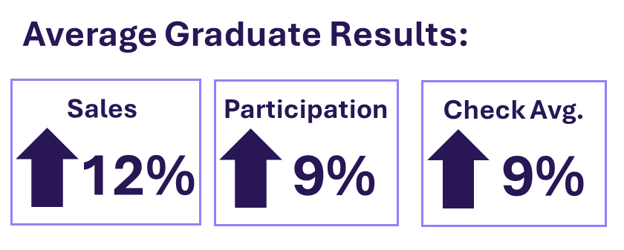
Retail Certification 2.0
Retail Certification 2.0 is a practical, application-based retail training designed to coach the fundamentals of retail, develop skills, and share tools that drive sales and profitability.
Target Audience:
Directors, Managers, Supervisors
Retail Leads
Learning Objectives:
Develop skills that grow retail sales, margin, and guest satisfaction
Understand and apply principles in consumer experience, analytics, product selection and placement, pricing, and more!
Key Focus Areas:
Module 1. Leveraging Data & Insights
Module 2: Pricing and Daypart Strategies
Module 3. Space Optimization & Product Assortment
Module 4. Promotional Planning
Training Structure & Resources
•Content developed by Compass SMEs (Strategic Pricing, Envision, Foodbuy)
•Guided training experience with an in-person coach and retail community support
•Interactive and applied learning
•Anticipated time commitment: 1-2 hours per module
•Available 24/7 at CompassGroupLearns
“Before this program, I never really ran promotions in the cafe. I tracked sales daily but didn't really look into item cost and movement on a level like I did for this course. Once I started offering bundles and working on marketing items, sales drastically increased”
- Retail Certification 2.0 Graduate

Slide 6



Hospitality Training: Case Study
After a series of promotions, in the summer of 2024, guest satisfaction began trending negatively. To address this, the Bank of America team in the Southeast region completed Hospitality 101 training in September 2024.
As a result, the SE Region's guest satisfaction scores increased from 3.45 to 3.91 out of 5 points.
110 Associates completed the training
14 Managers completed the training
"Hospitality 101 has made a positive impact, as noted by the (guest satisfaction) numbers. My region has trended ahead of the other two regions for the past three months."
Jason Goodnite,
Regional Director
Bank of America SE Region

